Slide 1

Solving Pentominoes and Sudoku Puzzles
With the Dancing Links Algorithm
Brian T. Hill
Notes:
Hello and welcome to Solving Pentomino and Sudoku Puzzles with the Dancing Links Algorithm. My name is Brian T. Hill.
(This presentation uses many animations. If you are following along with the notes, I will use the “rightwards arrow” character to indicate when to advance).
→

Slide 2













What is a Pentominoes puzzle?
F
L
I
P
S
T
U
V
W
X
Y
Z
Notes:
Some of you may be here because, like me, you love Pentominoes puzzles. I discovered them as a child, and I still enjoy playing with them today. Still, I begin by explaining what Pentominoes are. Pentominoes are geometric shapes that are created by taking five unit squares and aligning them along their edges in all the ways that create continuous shapes. → If you look at them funny, they may resemble letters of the alphabet, which suggests a naming convention that I will use throughout this presentation. I start with four shapes which I call F, L, I, and P. I put these first simply because they conveniently spell an easy-to-remember word. There are twelve Pentomino shapes in all. → The remaining shapes I call S, T, U, V, W, X, Y, and (wait for it . . .) Z.
The object of the Pentominoes puzzle is to combine and arrange these shapes into larger shapes. There are a variety of target shapes, the most common of which is the rectangle 10 units wide by 6 units tall. → I show here one possible solution to this puzzle. I say “one possible solution” because there are over 9,000 ways to combine the Pentominoes into a 10 x 6 rectangle. Even discounting rotational and mirrored equivalences, there are over 2,000 solutions.
This creates a phenomenon that simultaneously fascinates and frustrates me. Sometimes I can sit down for 45 minutes with a set of Pentomino pieces and fail to find any solutions. Yet, if I walk away and come back later, I might find a dozen different solutions within just five or ten minutes. I don’t know why it can sometimes be so easy, while baffling me at other times.
Long ago, I thought that a computer program should be able to examine all the possible arrangements of shapes to find all the solutions. However, I intuitively understood that such a program would have to be designed carefully as there are so many combinations that a naïve program would never complete. Consequently, I never undertook to write such a program. Last year, however, I ran across an interesting algorithm that could be used to efficiently find Pentominoes solutions. I found the algorithm quite intriguing. I studied it carefully until I was sure I understood it. This presentation reviews the things I learned. →

Slide 3

Agenda
Solving the Exact Cover matrix problem with Algorithm X
Optimizing with Dancing Links
Reducing Pentomino puzzles to an Exact Cover matrix problem
Reducing Sudoku puzzles to an Exact Cover matrix problem
Demo (source code available)
Notes:
Briefly, here’s the agenda for the remainder of the presentation. I’ll begin by describing a matrix problem known as the “Exact Cover” matrix problem. I will present an algorithm, called “Algorithm X”, for solving this problem, along with an optimization called “Dancing Links”. The Exact Cover problem does not specifically deal with Pentominoes (or Sudoku), so I will then explain how to use it to solve both types of puzzles. I will conclude with a demo of the program I wrote to showcase the algorithm in the context of these puzzles. (For those who are not a part of the live presentation, you may download the program and examine it for yourselves). →

Slide 4

Exact Cover Matrix Problem
Boolean matrix
Solution is a set of rows
“Cover” means column has a value
“Exact Cover” means each column has exactly one value
 | 1 | 2 | 3 | 4 | 5 | 6 | 7
1 | 0 | 0 | 0 | 0 | 0 | 1 | 1
2 | 0 | 0 | 0 | 1 | 1 | 0 | 0
3 | 0 | 1 | 0 | 0 | 0 | 1 | 0
4 | 1 | 0 | 1 | 1 | 0 | 0 | 0
5 | 1 | 0 | 1 | 0 | 0 | 0 | 1
6 | 0 | 1 | 0 | 1 | 0 | 1 | 0
Notes:
The Exact Cover problem is a matrix problem. You may be tempted to make connections between it and the Pentominoes puzzle. After all, with Pentominoes, we try to fill a 10 x 6 rectangle. That kind of resembles a matrix. And we wish to cover all of its spaces exactly with the various pieces. That sounds like an Exact Cover. However, that’s not quite how it works. I suggest you put aside thoughts of Pentominoes and Sudoku for a few minutes while we examine the problem generically. Afterwards, I will connect the dots.
The Exact Cover problem deals with a Boolean matrix. That means that each cell—each intersection of row and column—contains a True or a False, a 1 or 0, a value or no value. → As we search for solutions that meet our exact cover criteria, the solution will take the shape of a set of rows. It will be some sub-set of matrix rows that provide an exact cover. →
“Cover” in this case means that a column has a value somewhere in it. You can see in the example that Column 1 is covered because two rows (Rows 4 and 5) have a value in Column 1. → “Exact Cover” means that a column has exactly one value in it. Column 1 is not exactly covered by the entire matrix, since it has two values in it, so our solutions will be sub-sets of rows, each of which will include either Row 4 or Row 5, but not both. →

Slide 5

Algorithm X
If all columns are covered, we’re done!
Choose a column and remove it
Loop over each covering row
Tentatively add row to solution
Remove other columns covered by row
Remove other rows that also cover those columns
Recurse
Restore rows in step C
Restore columns removed in step B
Reject row from solution
Restore column removed in step II
(Don’t worry if these steps are confusing or overwhelming right now. The next several slides will go over these steps in detail.)
Notes:
Algorithm X is a recursive algorithm designed to find all solutions for the Exact Cover matrix problem. It was apparently so obvious and straightforward to Donald Knuth that he didn’t think the algorithm deserved a name. Thus, he called it simply, “Algorithm X”. → On this slide, I present the steps for the entire algorithm. Don’t worry if they don’t make sense, or if you can’t quite see how they work together to solve the problem. We will dive in deeply over the next few slides and look at a variety of visualizations. →
Step I: Check to see if we’ve covered all the columns yet. Of course, we haven’t; we haven’t begun yet! But remember, this is a recursive algorithm, so we’re going to run this step many times. This will allow us to recognize solutions and stop the recursion. →
Step II: We’ll need to eventually cover all the columns. For now, let’s pick a column that we want to work on. We remove that column from the matrix. →
Step III: We start a loop to examine each row that covers our chosen column, one at a time. →
Step III A: We don’t know yet whether the current row will work out or not, so for now we propose that it be part of our solution. That means that we add it to the working solution and remove the row from the matrix. →
Step III B: We know that the current row covers our chosen column, but it might cover additional columns, as well. We spot those and remove those columns from the matrix. →
Step III C: Because we are looking for an exact cover, no other row is allowed to cover these same columns. We spot those rows and remove them from the matrix. →
Step III D: We’ve now modified the matrix to remove any conflicts with our chosen column and row, so we can recurse to work on additional columns. →
Step III E: The recursion may or may not discover new solutions, but we don’t care. We’re almost ready to start looking for the next solution. But first, we need to repair the damage we’ve done to the matrix. Here, we restore the rows we removed in Step III C. →
Step III F: We restore the columns we removed in Step III B. →
Step III G: Since we’re done considering the current row, we place it back in the matrix and remove it from our working solution. With that done, we can return to the top of our loop and consider the next row. →
Step IV: That concludes our consideration of the current column. In fact, because of the recursion we performed, we are done considering all the columns. We restore our chosen column to the matrix, and we’re done. →

Slide 6

Visualizing Algorithm X, Part 1
Working solution:
{ 4 }
All columns covered?
Cover Column 1
Loop over rows
Tentatively add Row 4 to solution
Remove Columns 3, 4
Remove Rows 2, 5, 6
Recurse
 | 1 | 2 | 3 | 4 | 5 | 6 | 7
1 | 0 | 0 | 0 | 0 | 0 | 1 | 1
2 | 0 | 0 | 0 | 1 | 1 | 0 | 0
3 | 0 | 1 | 0 | 0 | 0 | 1 | 0
4 | 1 | 0 | 1 | 1 | 0 | 0 | 0
5 | 1 | 0 | 1 | 0 | 0 | 0 | 1
6 | 0 | 1 | 0 | 1 | 0 | 1 | 0
One level deep, loop iteration one
One level deep
Notes:
Don’t worry if those steps weren’t clear. Now we’ll dive deeper and begin to visualize the algorithm using our Boolean matrix from earlier. →
Step I: Are all the columns covered? No, of course not. We just started! →
Step II: We want to cover all the columns, so let’s choose one to start with. We’ll choose Column 1 and remove it from the matrix. →
Step III: We’ll begin a loop to consider each row that covers Column 1, one at a time. In this case, Rows 4 and 5 cover Column 1. We’ll first consider Row 4. →
Step III A: We propose that Row 4 should be part of the working solution. Remember that each solution will be a set of rows, so our partial working solution now consists of Row 4. We also remove Row 4 from the matrix. →
Step III B: Of course, Row 4 covers Column 1, which we are working on during this recursive pass, but we can see that Row 4 also covers two additional columns, Columns 3 and 4. We can knock those columns out early, so we remove them from the matrix. →
Step III C: Since we’re looking for an exact cover, no other row in our solution may cover any of the same columns as Row 4 does. We can see that Rows 2, 5, and 6 also cover some of the same columns, so we remove those from the matrix. →
Step III D: We’ve done as much as we can with our current row, Row 4, so it’s time to recurse. That means that we will run the very same algorithm, without change. The only difference will be the starting state. When we started the algorithm, our working solution was empty and we had a complete matrix. As we recurse, our working solution will contain Row 4 and our matrix has been drastically reduced. →

Slide 7

Visualizing Algorithm X, Part 2
Working solution:
{ 4, 3 }
{ 4 }
All columns covered?
Cover Column 2
Loop over rows
Tentatively add Row 3 to solution
Remove Column 6
Remove Row 1
Recurse
Restore Row 1
Restore column 6
Reject Row 3 from solution
Restore Column 2
 | 2 | 5 | 6 | 7
1 | 0 | 0 | 1 | 1
3 | 1 | 0 | 1 | 0
Two levels deep
Notes:
Here, we see that our second level of recursion starts with the updated working solution, and our matrix contains only four columns and two rows. →
Step I: Are all the columns covered? No, we have four columns remaining. →
Step II: We want to cover all of these columns, so let’s choose one to work on now. We’ll choose Column 2 and remove it from the matrix. →
Step III: Only one row, Row 3, covers Column 2, so we’ll consider it during our only pass through the loop. →
Step III A: We propose that Row 3 be added to our working solution, which will now contain Rows 4 and 3. We also remove Row 3 from the matrix. →
Step III B: We notice that Row 3 also covers Column 6, so we go ahead and remove Column 6 from the matrix now. →
Step III C: Since we need an exact cover, no other rows may cover any of the same columns as Row 3. We see that Row 1 also covers one of the columns, so we remove Row 1 from the matrix. →
Step III D: Now we are ready to recurse, to handle other columns. I don’t have a slide for the next level of recursion, but we can quickly walk through it here. During the next level of recursion, our working solution will be the set of Rows 4 and 3, and our matrix will be reduced to just two columns, Columns 5 and 7, and no rows at all. In Step I, we’ll find that we haven’t covered all the columns. Step II will decide to work on Column 5 and remove it from the matrix. Step III will find no rows, so the loop will not run. Step IV will restore Column 5 to the matrix. That ends that level of recursion without finding any new solutions. The algorithm then returns to where we left it at the second level of recursion. Did we really need to do a level of recursion to discover that we’re out of rows? Not necessarily. I consider this the core algorithm, but you may be able to optimize it by checking boundary conditions before recursing or starting the loop. →
Step III E: Now that recursion has returned, this level of recursion does not care whether any solutions were identified or not. After all, the algorithm will search for all solutions, so it continues just the same. We’re now done considering Row 3, but we need to repair the damage we’ve done to the matrix. Here, we put Row 1 back into the matrix. →
Step III F: We continue to repair the matrix by putting Column 6 back. →
Step III G: We now reject Row 3 from our working solution. “Reject” may be a strong term, since we don’t know if it was part of an actual solution, but it is no longer part of the solution we are currently working on. We remove it from our working solution, and we also put Row 3 back into the matrix. Since Row 3 is the last row that covers Column 2, we end the loop. →
Step IV: That completes our consideration of Column 2, so we put it back into the matrix. We are now done with this level of recursion, so we return to where we left off in our first level of recursion. →

Slide 8

Visualizing Algorithm X, Part 3
Working solution:
{ 4 }
{ }
All columns covered?
Cover Column 1
Loop over rows
Tentatively add Row 4 to solution
Remove Columns 3, 4
Remove Rows 2, 5, 6
Recurse
Restore Rows 2, 5, 6
Restore Columns 3, 4
Reject Row 4
 | 1 | 2 | 3 | 4 | 5 | 6 | 7
1 | 0 | 0 | 0 | 0 | 0 | 1 | 1
2 | 0 | 0 | 0 | 1 | 1 | 0 | 0
3 | 0 | 1 | 0 | 0 | 0 | 1 | 0
4 | 1 | 0 | 1 | 1 | 0 | 0 | 0
5 | 1 | 0 | 1 | 0 | 0 | 0 | 1
6 | 0 | 1 | 0 | 1 | 0 | 1 | 0
One level deep, loop iteration one
Notes:
Having completed our second level of recursion, we pick up the first level where we left off. We were working on Column 1, and we were in the middle of our first pass through the loop, considering Row 4. Our working solution contains only Row 4. →
Step III E: We are now done considering Row 4, but we have to repair the matrix before we can move on to Row 5. We put Rows 2, 5, and 6 back into the matrix. →
Step III F: We put put Columns 3 and 4 back into the matrix. →
Step III G: We reject Row 4 from our working solution and put Row 4 back into the matrix. Our working solution is now empty once again. We can now go back to the top of the loop. →

Slide 9

Visualizing Algorithm X, Part 4
Working solution:
{ 5 }
{ }
All columns covered?
Cover Column 1
Loop over rows
Tentatively add Row 5 to solution
Remove Columns 3, 7
Remove Rows 1, 4
Recurse
 | 1 | 2 | 3 | 4 | 5 | 6 | 7
1 | 0 | 0 | 0 | 0 | 0 | 1 | 1
2 | 0 | 0 | 0 | 1 | 1 | 0 | 0
3 | 0 | 1 | 0 | 0 | 0 | 1 | 0
4 | 1 | 0 | 1 | 1 | 0 | 0 | 0
5 | 1 | 0 | 1 | 0 | 0 | 0 | 1
6 | 0 | 1 | 0 | 1 | 0 | 1 | 0
One level deep, loop iteration one
One level deep, loop iteration two
Notes:
Step III A: This time through the loop, we will consider Row 5. → We propose that Row 5 should be part of the working solution, and we remove it from the matrix. →
Step III B: We notice that Row 5 also covers two additional columns, Columns 3 and 7, so we remove those columns from the matrix now. →
Step III C: Since we want an exact match, no other rows may cover the same columns. We see that Rows 1 and 4 each cover some of the same columns, so we remove those from the matrix. →
Step III D: That’s all we can do here for Row 5, so we recurse. →

Slide 10

Visualizing Algorithm X, Part 5
Working solution:
{ 5, 3 }
{ 5 }
All columns covered?
Cover Column 2
Loop over rows
Tentatively add Row 3 to solution
Remove Column 6
Remove Row 6
Recurse
 | 2 | 4 | 5 | 6
2 | 0 | 1 | 1 | 0
3 | 1 | 0 | 0 | 1
6 | 1 | 1 | 0 | 1
Two levels deep, loop iteration one
Two levels deep
Notes:
This time, our recursive pass begins with a working solution containing Row 5, and the matrix has been significantly reduced. →
Step I: Are all the columns covered? No, we have four columns remaining. →
Step II: We need to cover all the columns. For now, we pick Column 2 to work on. →
Step III: There are two rows, Rows 3 and 6, that cover Column 2, so we will run the loop twice to consider each one separately. →
Step III A: We propose that Row 3 be added to our working solution, and we remove it from the matrix. →
Step III B: We see that Row 3 also covers Column 6, so we remove that from the matrix. →
Step III C: Since we need an exact cover, no other row may cover the same columns. We see that Row 6 does that, so we remove it from the matrix. →
Step III D: We now recurse to our third level of recursion. →

Slide 11

Visualizing Algorithm X, Part 6
Working solution:
{ 5, 3, 2 }
{ 5, 3 }
All columns covered?
Cover Column 4
Loop over rows
Tentatively add Row 2 to solution
Remove Column 5
No more rows to remove
Recurse
No rows to restore
Restore Column 5
Reject Row 2
Restore Column 4
 | 4 | 5
2 | 1 | 1
Found solutions: { 5, 3, 2 }
Three levels deep
Notes:
This time, our working solution contains Rows 5 and 3, and our matrix has been reduced to just two columns and one row. →
Step I: Have we covered all the columns? No, we have two columns remaining. →
Step II: Let’s choose to work on Column 4, which we will remove from the matrix. →
Step III: There’s only one row that covers Column 4, so we will run through the loop once, considering Row 2. →
Step III A: We propose that Row 2 be part of the working solution, and we remove it from the matrix. →
Step III B: We see that Row 2 also covers Column 5, so we remove that from the matrix. →
Step III C: There are no more rows, so we don’t have to worry about other rows covering the same columns. →
Step III D: We now recurse to the fourth level of recursion. Our working solution will contain Rows 5, 3, and 2, and our matrix will have now rows or columns. I don’t have a slide for that, but we can quickly walk through it here. Step I: Are all the columns covered? Yes, they finally are, as we have no columns left! This means that we have identified a solution. You can handle that as you choose. You might add it to a log, or maybe you just want to count the solutions. My program, which I will demonstrate later, adds the solution to a collection so it can render them later. → Once that’s done, this recursive pass completes. We can skip the remaining steps and return to our previous state. →
Step III E: This level of recursion doesn’t care that we just identified a solution. We’re going to move on and look for more solutions. But first, we need to repair the matrix. Since we didn’t remove any rows in Step III C, we don’t have any to restore here. →
Step III F: We put Column 5 back into the matrix. →
Step III G: We reject Row 2 from our solution. Yes, it was actually part of a real solution, but we’re ready to look for the next one. We remove it from the working solution, and put it back into the matrix. We have no more rows, so we end the loop. →
Step IV: We’re done working on Column 4, so we put it back into the matrix. →

Slide 12

Visualizing Algorithm X, Part 7
Working solution:
{ 5, 3 }
{ 5 }
All columns covered?
Cover Column 2
Loop over rows
Tentatively add Row 3 to solution
Remove Column 6
Remove Row 6
Recurse
Restore Row 6
Restore Column 6
Reject Row 3
 | 2 | 4 | 5 | 6
2 | 0 | 1 | 1 | 0
3 | 1 | 0 | 0 | 1
6 | 1 | 1 | 0 | 1
Found solutions: { 5, 3, 2 }
Two levels deep, loop iteration one
Notes:
We return to our second recursion level just where we left it. We had been working on Column 2, and we were considering Row 3 during our first pass through the loop. → Before we can consider Row 6 during our second loop iteration, we need to repair the matrix by restoring Row 6 and then Column 6. We’ll reject Row 3 by removing it from our working solution and adding it back to the matrix.
I won’t bother walking through the next loop iteration. Spoiler alert: It doesn’t find any new solutions. →

Slide 13

Exact Cover, Solved
The set of rows { 5, 3, 2 } exactly covers all the columns
 | 1 | 2 | 3 | 4 | 5 | 6 | 7
1 | 0 | 0 | 0 | 0 | 0 | 1 | 1
2 | 0 | 0 | 0 | 1 | 1 | 0 | 0
3 | 0 | 1 | 0 | 0 | 0 | 1 | 0
4 | 1 | 0 | 1 | 1 | 0 | 0 | 0
5 | 1 | 0 | 1 | 0 | 0 | 0 | 1
6 | 0 | 1 | 0 | 1 | 0 | 1 | 0
Notes:
The final result is a single solution containing rows 5, 3, and 2. As you can see here, → this set of rows exactly covers every column, having a single value in each.
That demonstrates Algorithm X. I think there is a certain elegance to it. However, you may have noticed a disturbing aspect of the algorithm. It requires quite a few modifications to the matrix. Specifically, it requires that we remove—and subsequently re-add—entire rows and columns. Many times. This could be a problem. After all, a common representation for a matrix is an array. Using Algorithm X with arrays would require a lot of bulk-moving memory around. That’s where our Dancing Links optimization comes in. →

Slide 14

Dancing Links, Part 1
Convert matrix to a complex linked list
Keep the header row and the “1” values
 | 1 | 2 | 3 | 4 | 5 | 6 | 7
root
1
2
3
4
5
6
7
1
0
0
0
0
0
1
1
2
0
0
0
1
1
0
0
3
0
1
0
0
0
1
0
4
1
0
1
1
0
0
0
5
1
0
1
0
0
0
1
6
0
1
0
1
0
1
0
Notes:
Because adding and removing entire rows and columns to an array-based matrix is so expensive, we’re going to use a different matrix representation. Instead of using an array, we’ll represent the matrix as a linked-list, albeit a rather complicated one. → We start by keeping only the cells that have a value in them. We keep the header row too, but we get rid of everything else. →

Slide 15

Dancing Links, Part 2
Convert matrix to a complex linked list
Keep the header row and the “1” values
Doubly-link the nodes in each row
Doubly-link the nodes in each column
root
1
2
3
4
5
6
7
1
1
1
2
1
1
3
1
1
4
1
1
1
5
1
1
1
6
1
1
1
Notes:
Next, we connect the nodes in each row. We connect each node to the previous node in the row, as well as to the next node in the row, creating a doubly-linked list. Furthermore, we “wrap around” each row, connecting the last node to the first, and vice versa. This turns our matrix into a cylinder, if you want to visualize it like that. →
But we’re not done yet. We then connect the nodes in each column in doubly-linked vertical lists. We wrap these around too, connecting the first and the last nodes in each column. Instead of a cylinder, we can visualize this as a toroid. I prefer to visualize it in two dimensions, as what I call a “tapestry”.
What’s the point of this complicated arrangement? We’ve added four pointers to all the cells that have values. Doesn’t that negate some of the savings or removing the empty cells? Yes, but that’s not what we’re trying optimize. We’ll still save space as long as our matrixes are sparse—which they will be—but we didn’t apply this optimization to save space. We did this to avoid the costly performance of adding and removing rows to an array. →

Slide 16

Why a linked list?
Removing a node
Re-inserting a node
// remove from row
node.left.right = node.right;
node.right.left = node.left;
// re-insert in row
node.left.right = node;
node.right.left = node;
// remove from column
node.above.below = node.below;
node.below.above = node.above;
// re-insert in column
node.above.below = node;
node.below.above = node;
Notes:
Let’s review how to remove a node from a doubly-linked list. → We simply need to tell the node’s neighbors to skip over the node. That requires us to navigate to the node’s left neighbor and update its right pointer. Then we navigate to the node’s right neighbor and update its left pointer. We can take similar steps to remove the node from its vertical list.
You may have noticed that while we modified the node’s neighbors, but we didn’t modify the node itself. Specifically, we didn’t null out its own pointers to its neighbors. That’s not uncommon. Nodes are often removed from a list just before they are deleted. It isn’t necessary to null out its pointers just before it gets deleted. For us, though, there is a more deliberate purpose. By leaving the node intact, we create a situation in which the list doesn’t know anything about the node, but the node still acts like it’s part of the list. The list has forgotten all about the node, but the node remembers where it once was.
We use this fact when we reinsert the node. → The steps for reinserting a node are very similar to the steps for removing it. We simply tell the node’s neighbors to stop skipping the node. Since the node never forgot who its neighbors were, we can find them using the node’s own pointers. We tell them to stop skipping the node simply by having them point to the node again. This technique works as long as the list is in the same state as it was when the node was removed.
These steps are not complicated, though they are precise. The program must follow them carefully to get the correct result. Donald Knuth thought this was a carefully choreographed set of steps. And what do you call it when you follow a carefully choreographed set of steps? A dance. So, Knuth called this the Dancing Links technique. When used with Algorithm X, it is known as Dancing Links with Algorithm X, or DLX, for short.
Note that when we use Dancing Links with Algorithm X, removing an entire column means removing each node in that column from its horizontal neighbors. The column itself can remain intact with its nodes still connected vertically. Similarly, removing an entire row means removing each node in that row from its vertical neighbors only.
That concludes our whirlwind tour of Algorithm X and Dancing Links, but what does any of that have to do with Pentominoes puzzles? Now we can turn our attention to that question. →

Slide 17

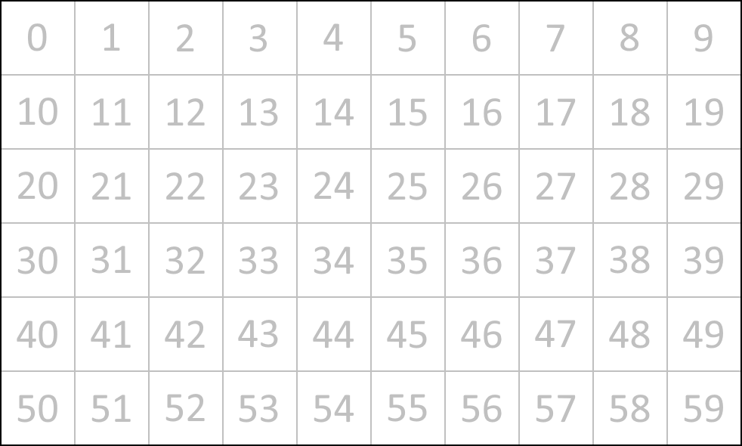
Pentominos Placements
60 spots on board
Each piece fills 5 spots
Pieces can be placed in any position that fits
Pieces can be rotated
Pieces can be flipped
Notes:
Remember that our objective is to place the twelve Pentomino pieces into a 10 x 6 rectangle. → The rectangle, therefore, has 60 spots that we wish to fill with the shapes. → Each shape will fill five of those spots. → The shapes can be placed anywhere in that space.
Furthermore, the shapes can be rotated. → Clockwise, counterclockwise, 180°. In each of those orientations, they can be placed anywhere on the board. →
Pieces can even be flipped over. → And those flipped pieces can be rotated and moved around.
All of these placements are valid, creating a large number of possibilities. →

Slide 18

How many placements are there?
I: 56
placements
L: 248 placements
P: 304 placements
F: 256 placements
Y:
248 placements
U: 152 placements
T: 128 placements
S: 248 placements
V: 128 placements
Total: 2,056 placements
86,794,071,842,037,495,268,114,432 combinations
W: 128 placements
X: 32 placements
Z: 128 placements
Notes:
How many ways can a piece be placed? That depends on the piece. Some pieces, like the “F”, can be rotated in four different orientations, and each can be flipped, resulting in eight orientations. → Others, like the “I” have fewer orientations because some rotations and flips are equivalent. The “X” has only a single orientation! The compactness of the shape can also affect how many places it can fit on the board. While the “L” and the “P” both have eight orientations, for example, the “P” is more compact and therefore has more possible placements on the board. →
In total, there are 2,056 different ways to place a single piece on the board.
Remember when I suggested a program might take all the combinations of piece placements to find solutions by brute force? That would mean taking each of the F’s 256 placements and trying them in combination of each of the L’s 248 placements. And then taking each of those combinations and trying them with each of the I’s 56 placements, and so on. → Good luck completing this strategy, as there are over 86 septillion total combinations!
The DLX algorithm will help us short-circuit these combinations. →

Slide 19

Pentominoes Exact Cover Matrix: Rows
Each matrix row represents a single placement of a Pentomino piece
All possible placements have a row
2,056 placements = 2,056 rows
Notes:
We know that DLX requires a matrix of rows and columns. I’ve also told you that the matrix doesn’t resemble the Pentominoes board. It’s time to reveal what the rows in the matrix represent. →
Each row will represent a single placement of a Pentomino piece. → Every possible way to placing a single Pentomino piece on the board will have a row in the matrix. → We’ve just seen that there are 2,056 possible piece placements, so our matrix will have 2,056 rows.
It’s that simple. Understanding the columns in the matrix will be a little more complicated. →

Slide 20

Pentominoes Exact Cover Matrix: Columns
Each matrix column must be uniquely covered in the solutions
Each Pentomino piece must be used exactly once
Therefore, twelve columns represent the twelve Pentomino pieces
Each of the 60 spots on the board must be covered exactly once
Therefore, 60 columns represent the 60 spots on the board
Twelve piece columns plus 60 board columns = 72 columns
Matrix is 72 × 2,056
Notes:
We know that each matrix column must be uniquely covered in the solutions. → We also know that each Pentomino piece must be used exactly once. Does that mean we can use matrix columns to represent Pentomino pieces? → Yes, it does. We’ll use twelve columns to represent the twelve Pentomino pieces, but we’re not done yet. →
Each of the 60 spots on the board must be filled. Overlapping pieces are not allowed. → Therefore, we can represent these 60 spaces with 60 more matrix columns. →
With 12 piece columns and 60 board columns, we have a total of 72 columns. → Our entire matrix will be 72 columns wide by 2,056 rows tall. →

Slide 21

Pentominos Exact Cover Matrix: Diagram
F
L
I
P
S
T
U
V
W
X
Y
Z
Notes:
Let’s take a closer look. → We have twelve Pentomino pieces and 60 board spaces. Each row in the matrix will represent a single piece placement. → Let’s see what that looks like for the “F” piece placed somewhere in the middle of the board. →
The first twelve matrix columns represent the pieces. In this row, only the “F” column will have a value in it.
The remaining 60 matrix columns represent the board spaces. In this row, only five of them will have a value. Those five columns represent the spaces in the board covered by the “F”.
As you can see, our matrix will be quite sparse. Only six of the 72 columns will have values in them.
With that information, you can create a matrix for all possible placements of Pentomino pieces, and the DLX solver can find the puzzle solutions. →

Slide 22

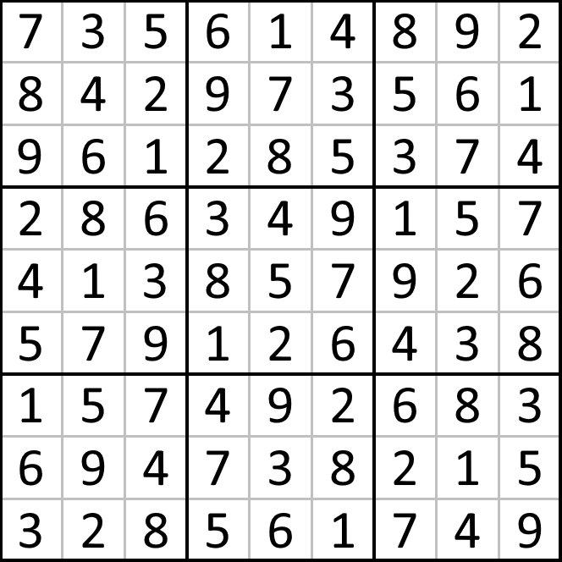
What about Sudoku?
9 × 9 board
One digit (1-9) in every space
Each digit exactly once in each row
Each digit exactly once in each column
Each digit exactly once in each box
Notes:
That wraps up our examination of Pentominoes. Now let’s see how DLX can help solve Sudoku puzzles.
Sudoko boards are typically 9 x 9 and filled with the digits 1 - 9. There are four rules that govern the placement of digits. →
There must be a digit in every space. In other words, the entire board must be filled with digits. →
Each digit must appear exactly once in each row. →
Each digit must appear exactly once in each column. →
Each digit must appear exactly once in each “tri-tile” box. →

Slide 23

Matrix Rows
Rows represent the digit placements
9 possible digits
9 possible rows
9 possible columns
9 * 9 * 9 = 729 matrix rows
Row index = DRC = d * 81 + r * 9 + c
Notes:
For Pentominoes, we let the DLX matrix rows represent all the possible placements of the pieces. Similarly, with Sudoku we will let the DLX matrix rows represent all the possible ways to put a digit in the board. → There are 9 digits and 81 spaces, so there are 729 possible ways of placing a digit.
With a little math, we can figure out what each matrix row index represents. → We can decode the index into the digit, row, and column that pertain to that matrix row. And vice versa. →

Slide 24

Matrix Columns
Digit placements in each constraint
One digit in every space
9 rows * 9 columns = 81 matrix columns
Each digit exactly once in each row
9 digits * 9 rows = 81 matrix columns
Each digit exactly once in each column
9 digits * 9 columns = 81 matrix columns
Each digit exactly once in each box
9 digits * 9 boxes = 81 columns
324 matrix columns * 729 matrix rows
Notes:
Just like with Pentominoes, Sudoku’s use of matrix columns is more complicated than the matrix rows. Because each digit will be reused 9 times, we can’t map the digits to a matrix column as we did with Pentomino pieces. We can map the 81 board spaces to matrix columns, but that’s just part of the story.
I previously described four rules that govern digit placement. We will use matrix columns to measure our compliance with each of these four rules. →
One digit in every space on the board. Thus, we use 81 matrix columns for this constraint. →
One of each digit in each row. There are nine digits and nine rows, so we use 81 matrix columns for this constraint. →
One of each digit in each column. There are nine digits and nine columns, so we use 81 matrix columns for this constraint. →
One of each digit in each tri-tile box. There are nine digits and nine tri-tile boxes, so we use 81 matrix columns for this constraint. →
That means the DLX matrix for Sudoku will have 324 matrix columns and 729 matrix rows. →

Slide 25

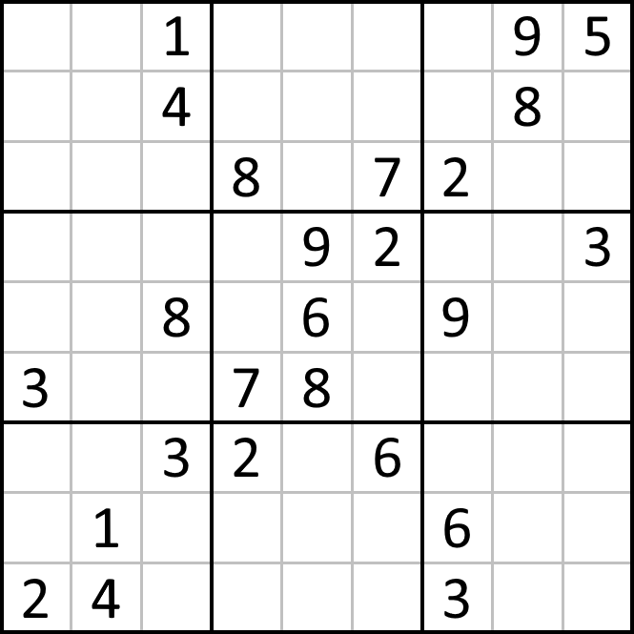
Finding the One and Only Solution
Puzzle starts with some digits filled in
Starting values ensure that there will be only one solution
For each provided value . . .
Compute DRC row index for all other digits
Clear all columns for those matrix rows
Notes:
With that, you can now use DLX to find every possible solution to an empty Sudoku board. (Well, the algorithm will probably never complete, since I understand there to be over 6 sextillion solutions). But Sudoku puzzles are supposed to have only one possible solution. They accomplish that by pre-filling some of the digits in the board. These serve both as hints as well as constraints. How do we use DLX with these hints provided?
We don’t need to alter the DLX algorithm to handle this. Instead, we’ll alter the input. That is, we’ll modify the matrix we provide to the DLX solver. →
We examine each of the pre-set digits. Remember that we can use simple math to map those digit placements to a matrix row. In this case, we don’t want to map those placements placements to matrix rows, → but the placements for all of the other digits in those locations. For example, on the screen we see the digit 1 in the third column, first row. Our math will use 0-based rows (0), columns (2), and digits (0), so the row index for that placement would be 0 * 81 + 0 * 9 + 2 = 2. But that matrix row is just fine. In fact, it’s required now to be part of the solution. So we won’t touch that row. Instead, we’ll touch the placement for the digit 2 in the same spot. The matrix row for that is 1 * 81 + 0 * 9 + 2 = 83. We’ll also compute the matrix row index for digits 3 - 9. Every digit except the digit provided. → Once we compute those matrix row indexes, then we will clear all the columns in those rows. That way, the DLX algorithm cannot select any of those rows as candidates for a solution. We could delete those rows, but that would mess up our row index math. →

Slide 26

Where do starting digits come from?
Work backwards and forwards
Start with a valid, complete board, remove digits
Give DLX algorithm a limit
“Solve” one solution for an empty board
Randomize matrix rows to get a different result each time
Randomly remove digits, check for two solutions
Put digit back if there are multiple solutions
4
1
6
3
7
8
9
2
5
2
9
5
1
6
4
3
7
8
8
3
7
9
5
2
4
1
6
3
8
2
7
4
9
6
5
1
1
5
4
6
2
3
8
9
7
7
6
9
8
1
5
2
4
3
9
2
3
5
8
7
1
6
4
6
7
8
4
9
1
5
3
2
5
4
1
2
3
6
7
8
9
Notes:
If Sudoku puzzles start with pre-filled hints that guarantee there will be a single solution, where do those hints come from? How can you create your own starting positions? There may be a variety of ways to accomplish this, but since I just implemented a great DLX solver, I decided to use it in a couple of new ways. →
To create a starting position, we work both forwards and backwards. → For example, we start with a solved board and work backwards by removing digits until we reach the starting position. But how do we get the completed board in the first place? For that, I decided to make a slight modification to our DLX algorithm. As it stands now, the DLX algorithm searches for all possible solutions. In this case, we only want one. → So, we add a “limit” parameter to tell the DLX to stop looking for solutions if it reaches this limit. → Now we can ask the solver for a single solution and use that as our completed board. Except . . . the solver is deterministic and will find the same board every time. I don’t want any randomness in the solver, but I don’t mind some randomness in the matrix. → So, we shuffle the rows in the matrix. Because we rely on math to decipher row indexes, we have to keep track of each row’s original position.
Now we use the DLX to solve forward to a completed board, and then we work backwards by removing digits until we reach our desired starting state. How do we know when we have reached that state? If we were to remove a single digit from a completed board, the constraints would only allow us to place that same digit back. If we removed two digits, only those same two digits could be placed back in. If we continue removing digits, however, we will eventually reach an ambiguous state. We wouldn’t have enough constraints remaining to guarantee that only a single solution exists. Thus, we can only remove digits as long as there exists only one possible solution. How do we know how many solutions there are? Fortunately, we have the DLX solver to answer that. But we don’t actually need to know how many solutions there are. We only need to know if there are more than one. → Thus, we can use the limit parameter we added to the solver and set a limit of two. As long as the solver finds only one solution, we can continue removing digits. → If the solver finds two solutions, we have to put the digit back. Even then, we might not be done. That means that particular digit can’t be removed, but we may find another that we can still remove.
Our final strategy looks like this: We solve forward with a limit of one and a shuffled matrix to find our completed board. Then we work backwards by looping through all 81 digits on the board in random order. → Each time, we remove the digit and solve forward with a limit of two. If we find two solutions, we put the digit back. Otherwise, we leave the digit off. Either way, we move to the next spot on the board in random order. When we’ve gone through all the spaces, whatever digits remain on the board are the starting position. →

Slide 27

Demo
Source code available at https://github.com/brian-t-hill/Dlx
This slide deck available at https://github.com/brian-t-hill/Dlx/raw/main/Docs/Dancing%20Links.pptx
Notes:
(If you are following along with the notes, the demo probably isn’t all that interesting. The program takes several seconds to compute all the Pentominoes solutions, and then renders one on-screen. It allows the user to navigate between all the solutions. The Sudoku portion presents an empty board, allowing the user to fill in digits. Solving an empty board will never finish, as there are over six sextillion possible solutions, but it will show statistics about how much work the algorithm does. The program allows contains a Randomize button, which will fill in the Sudoku board with starting digits. Solving these boards is nearly instantaneous. Perhaps of more interest will be to download the source code and examine it. This will provide you with access to a working implementation of the algorithm presented here).

